Slide 1
Celine Dion concert
Basic Art Management 2022

Slide 2
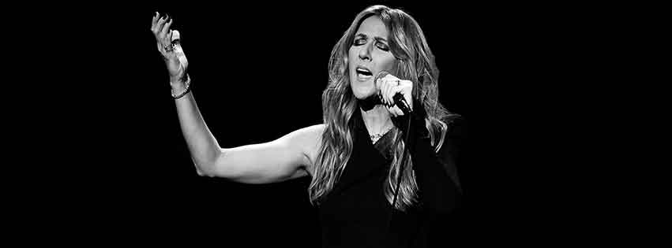
TARGETED AUDIENCE
GENDER
Women: 64.9%
Men: 35.1%
AGE
Range 25-34 (29.3%)

Slide 3
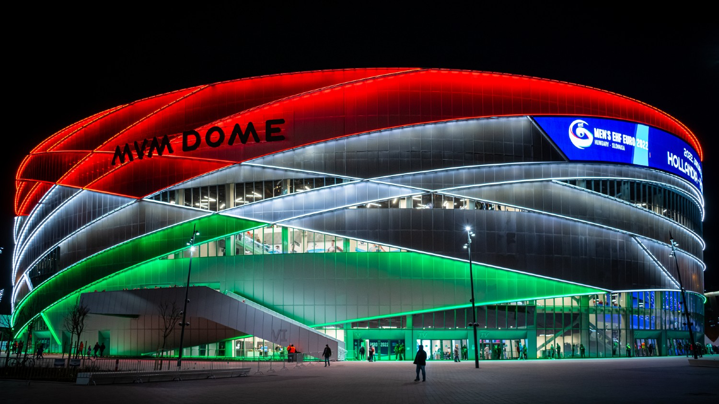
VENUE

Slide 4
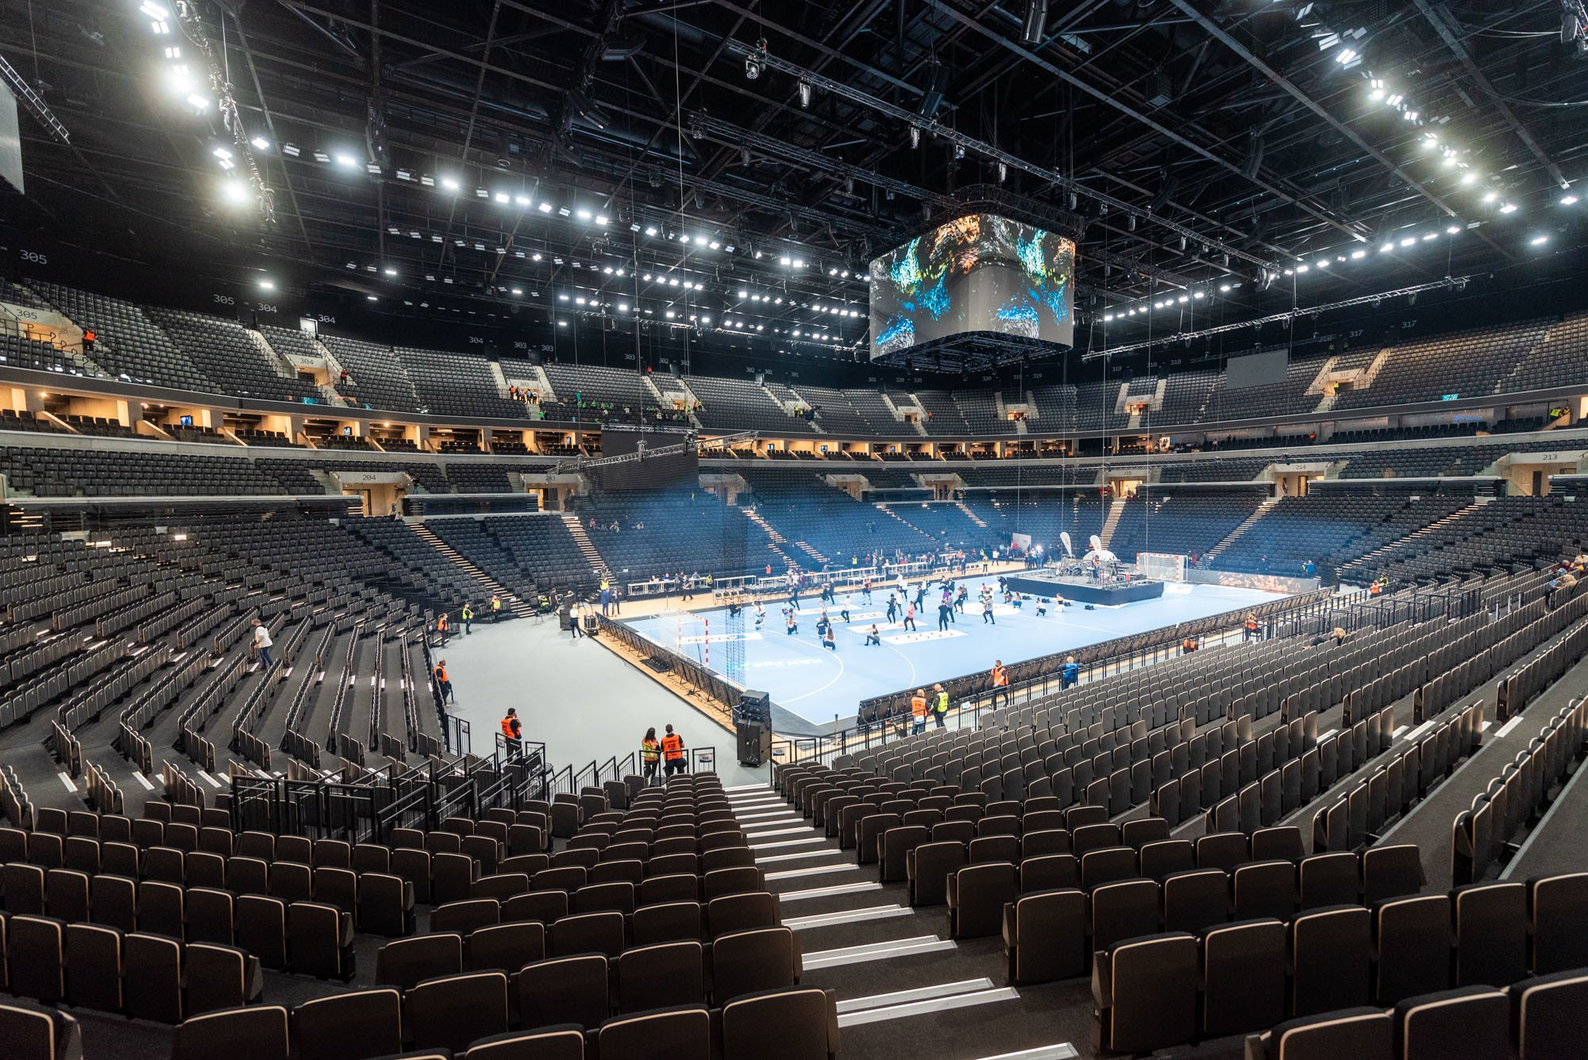
20 028
2021
VENUE
MVM Dome (Budapest Multifunctional Arena)
Stadium’s capacity
Opened
Notes:
This stadium’s capacity is over 20000.
It is an indoor stadium so we don’t need to worry about weather risks. → minimize risk when holding the show
Newly opened in December 2021 → better infrastructure ( built-in lights, LED screen, etc.)
Has held lots of famous international stars’ concert (e.g. Micheal Bublé, Sir Tom Jones, Enrique Iglesias, Plácido Domingo, ...)
Also by choosing this arena – a property of MVM group, we can reduce production cost and maximize our financial result by dealing w the company for sponsorship

Slide 5
CONCERT TIMELINE
18:30
Check-in
2 hours
19:30
21:30
INTRO
ENCORE
Notes:
The concert is expected to last approximately 2 hours starting from 7.30 to 9.30pm.
However there is often an interval of 15-20mins length in the timeline, or even longer depending on the circumstances that arise during the show → be prepared to minimize the risk
Check-in desk usually opens an hour before the actual show time

Slide 6
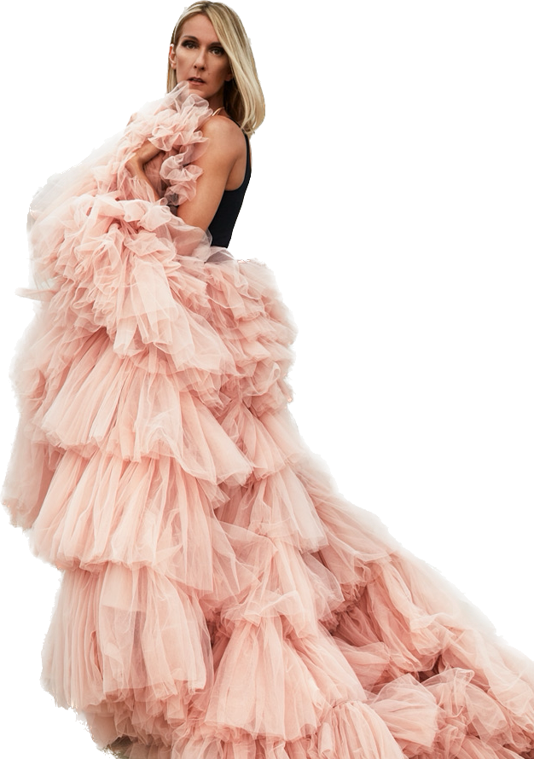
SETLIST
INTRO
It's All Coming Back To Me Now
That's The Way It Is
I'm Alive
If You Asked Me To
The Power Of Love
Love Can Move Mountains
Beauty And The Beast
Interlude
The Prayer
You're The Voice
Tous Les Blues Sont Écrits Pour Toi
To Love You More
Courage
All By Myself
Lying Down
Interlude ballet
The Reason
Imperfections
Because You Loved Me
S'il suffisait d'aimer
Dance Medley
My Heart Will Go On
Imagine
ENCORE
Notes:
Here is an example of a setlist of Celine Dion’s concert, the key points when building a setlist r to make reasonable combinations of her hits, songs from new album and at least one French-language song to alternate w each other.
The song titles in bold r hits, the rest comes from the new album or for example:
Interlude ballet to show her side skill
Dance medley at the very end part of the setlist to hype up the arena

Slide 7
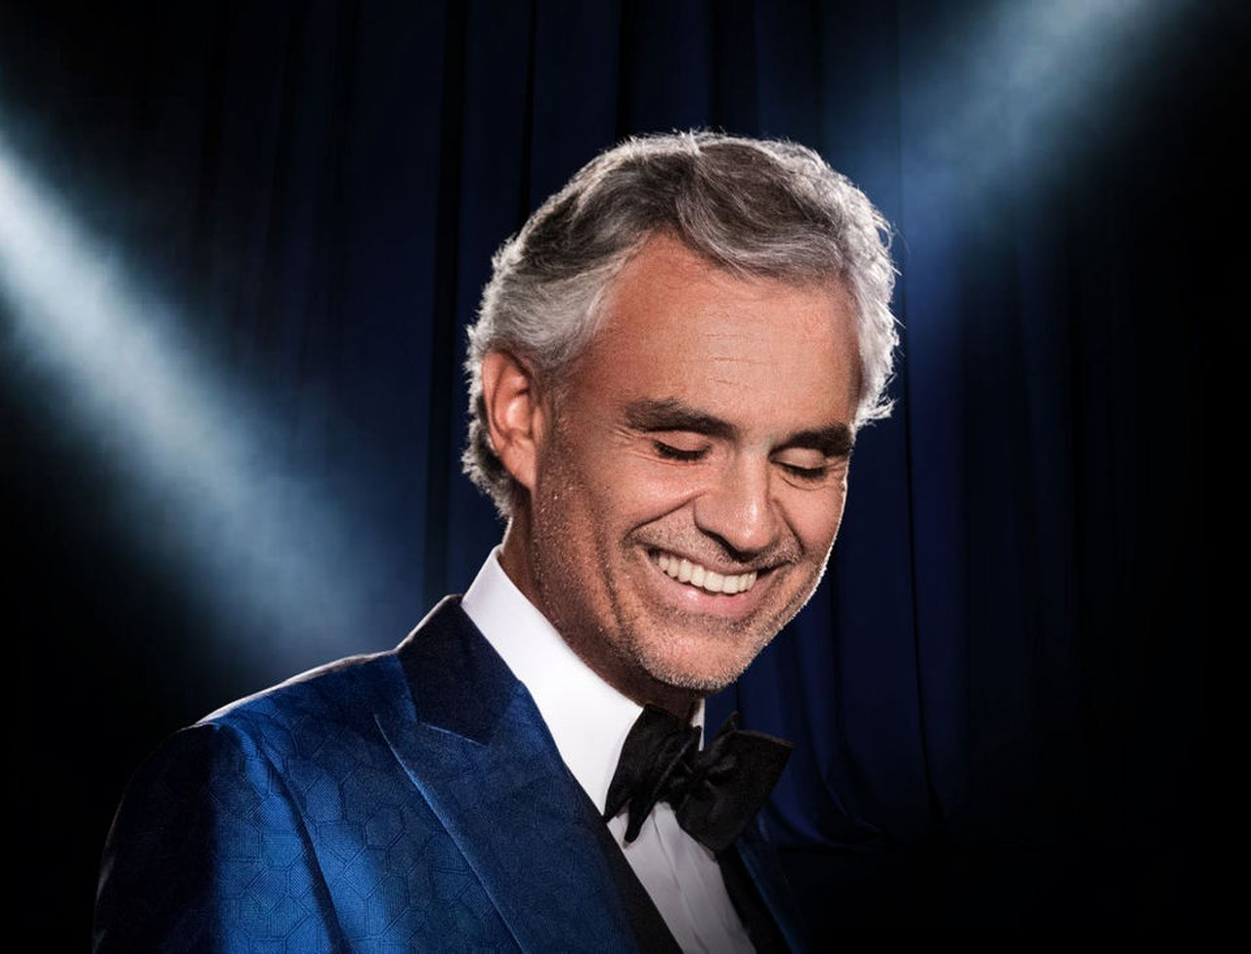

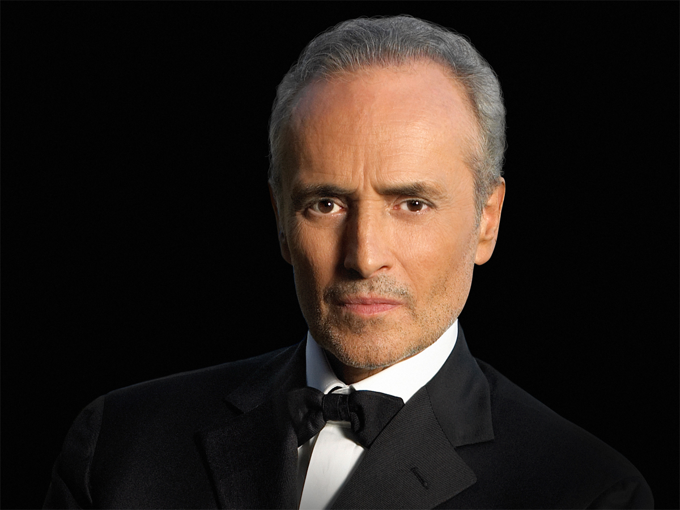
PROMOTER
Andrea Bocelli
Broadway Ticket Office
José Carreras

Slide 8
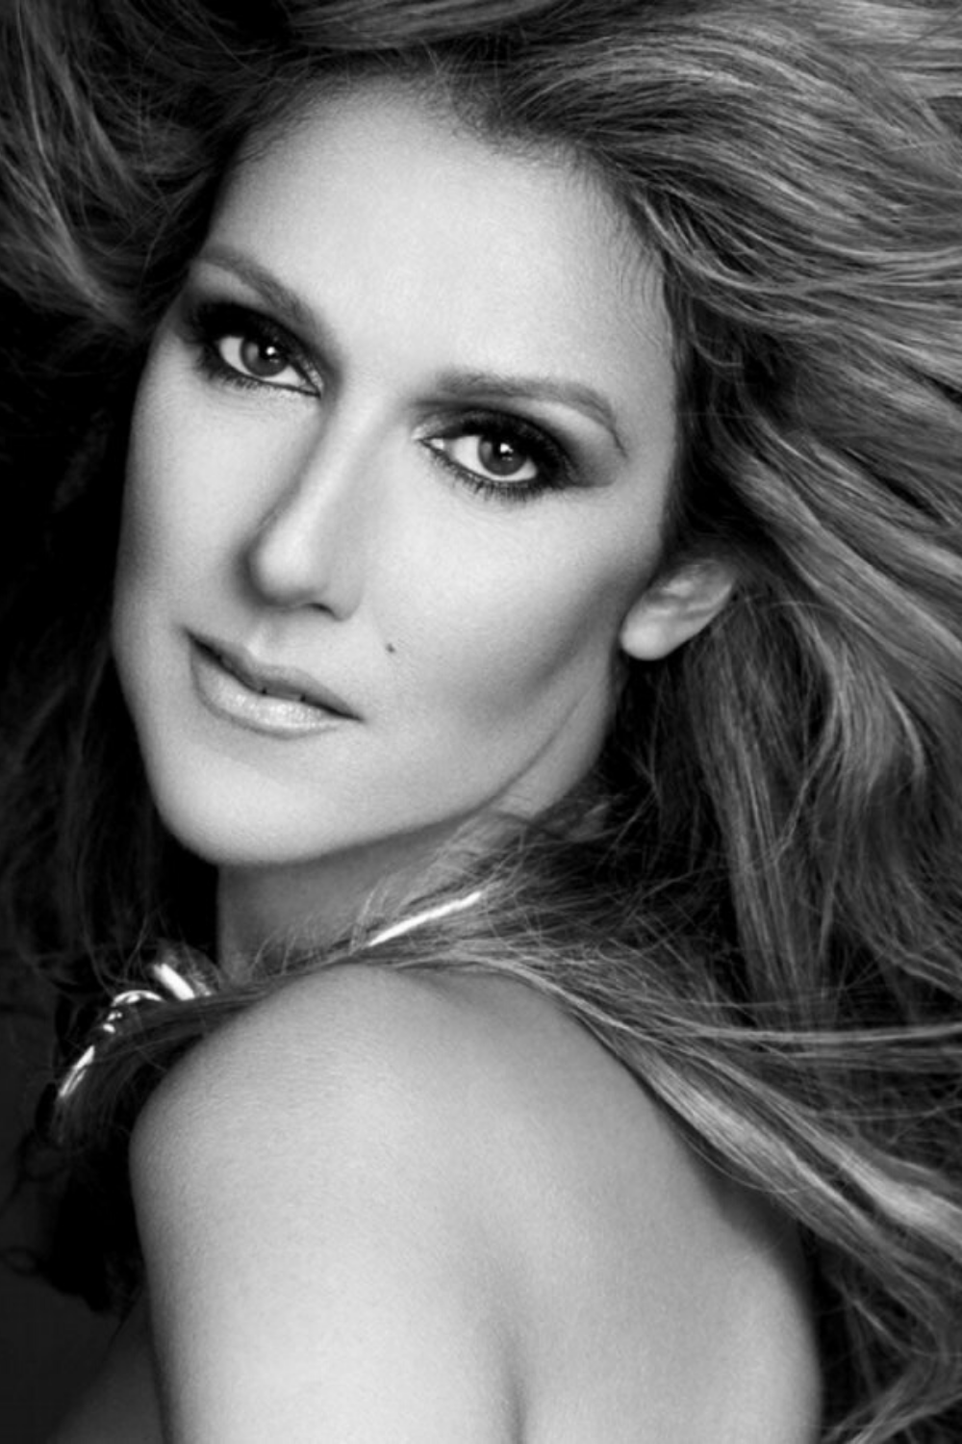
Maximize financial result & Minimize risks

Slide 9


Maximize financial results
Live album
Live concert CDs, DVDs

Slide 10
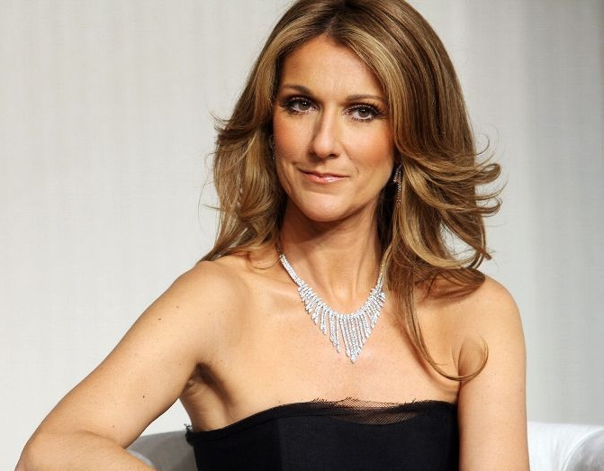




Maximize financial results
Live album
Behind the scenes
Live concert CDs, DVDs
Documentaries, short videos, interviews

Slide 11


Maximize financial results
Live album
Behind the scenes
Live concert CDs, DVDs
Documentaries, short videos, interviews
Livestream
dreamstage.live
veeps.com

Slide 12
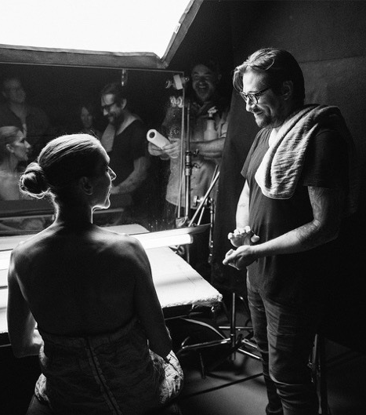
Maximize financial results
Live album
Behind the scenes
Live concert CDs, DVDs
Documentaries, short videos, interviews
Livestream
Rehearsals
dreamstage.live
veeps.com
Sell tickets

Slide 13

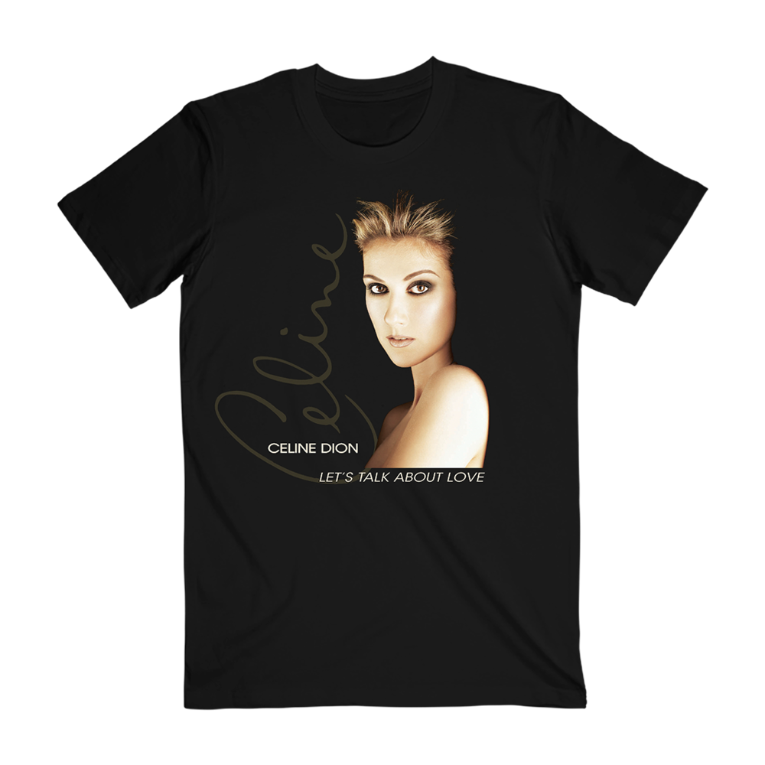
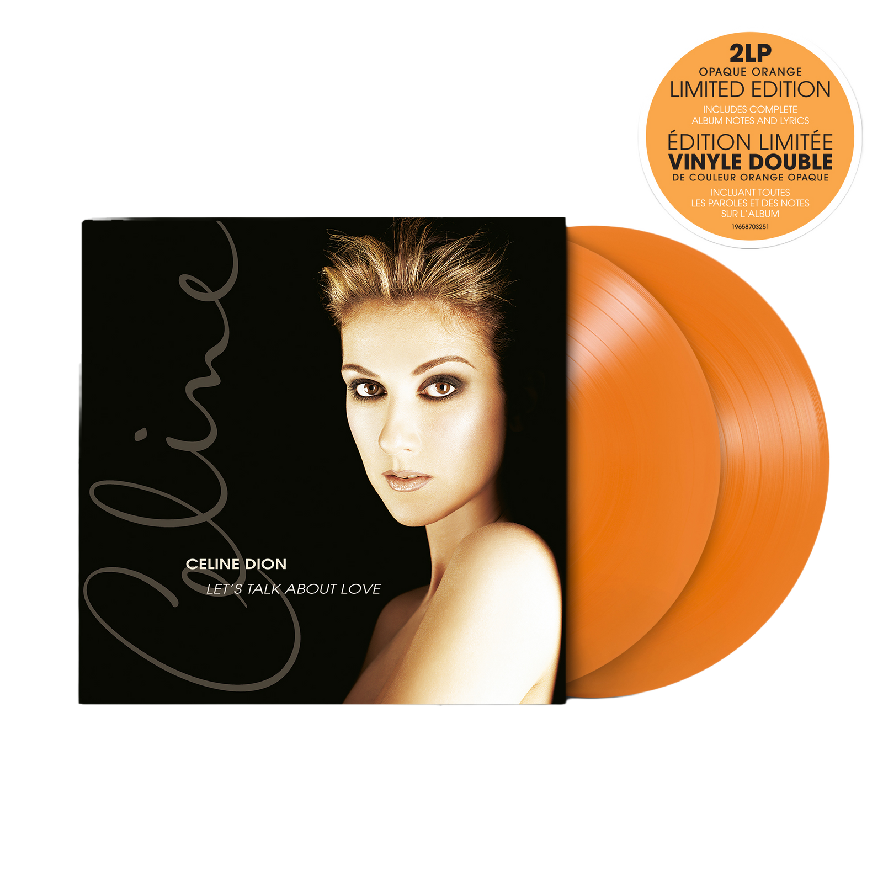

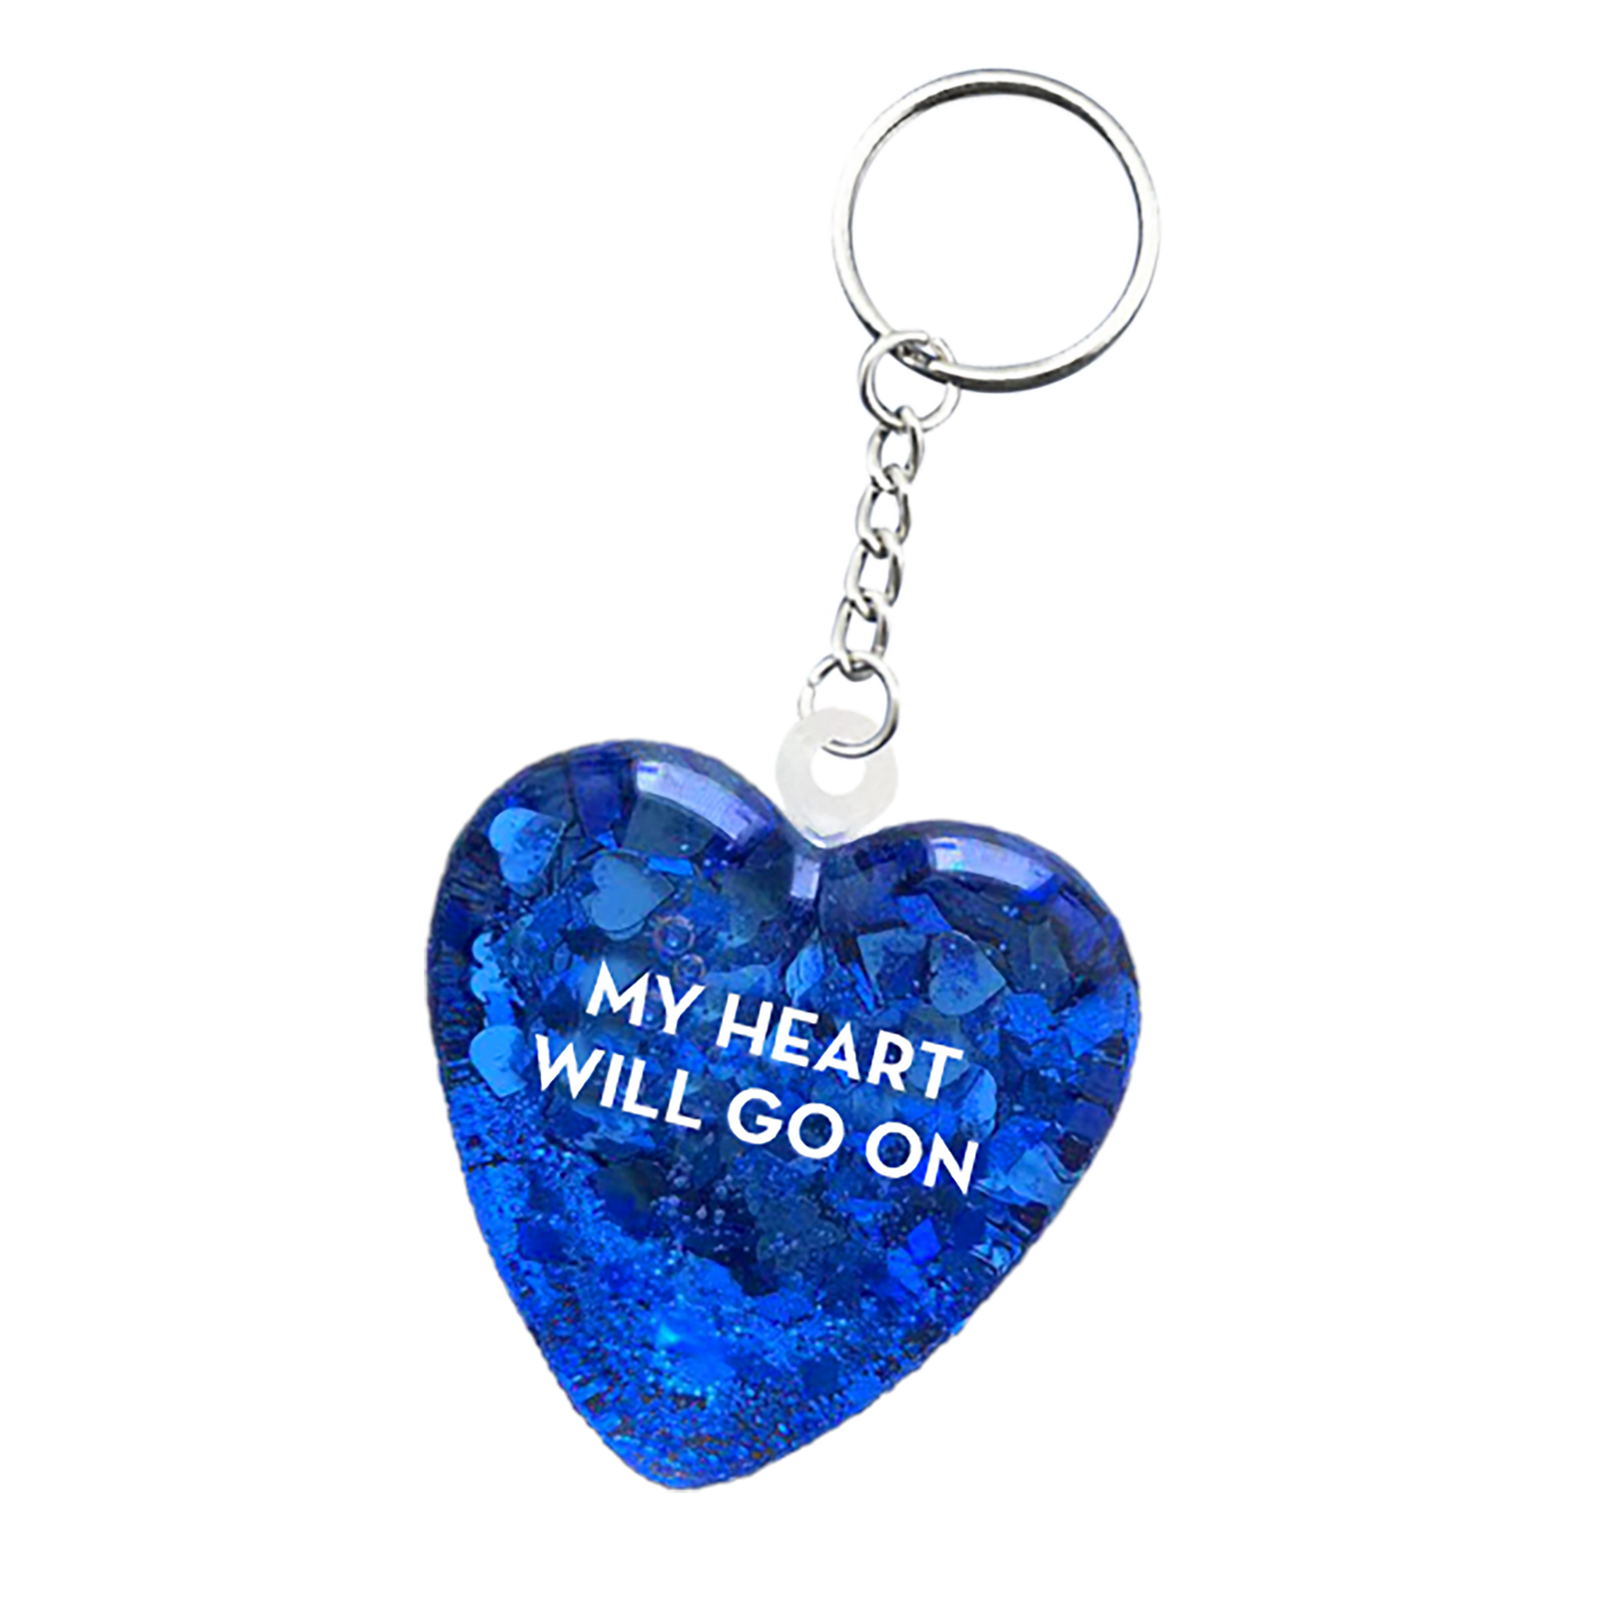
MERCHANDISE
https://boutique.celinedion.com/

Slide 14
SPONSORSHIPS
01
03
02
02
04
Venue Accommodation
Fashion Beauty
Car brands
Others

Slide 15

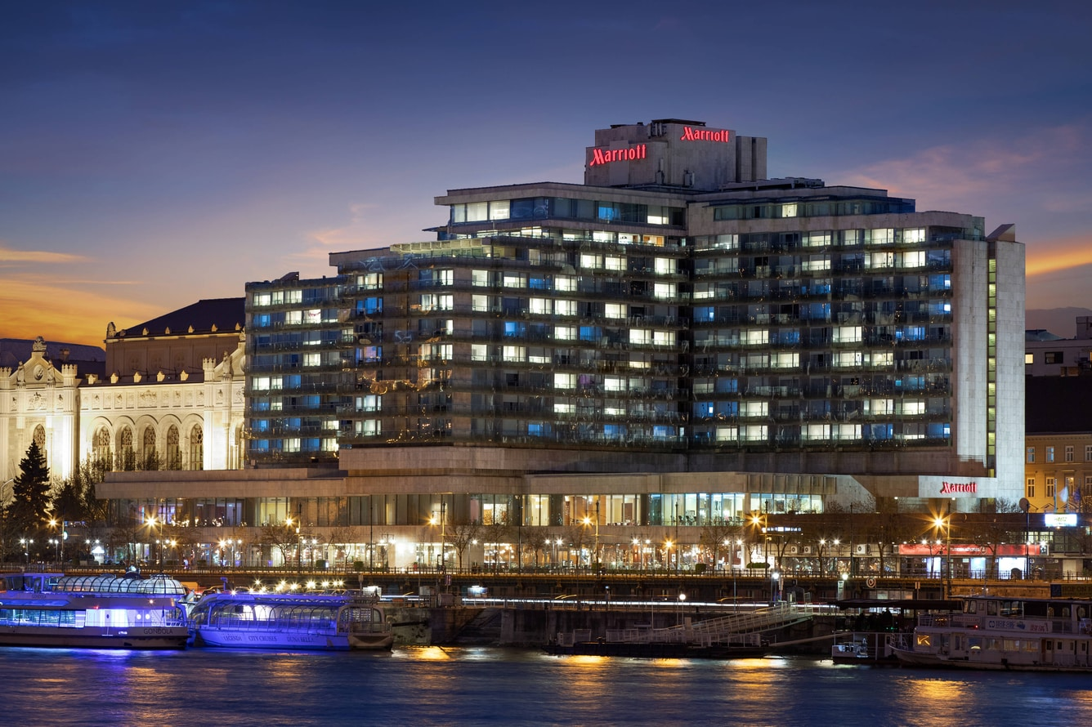

01
Venue & Accommodation

Slide 16
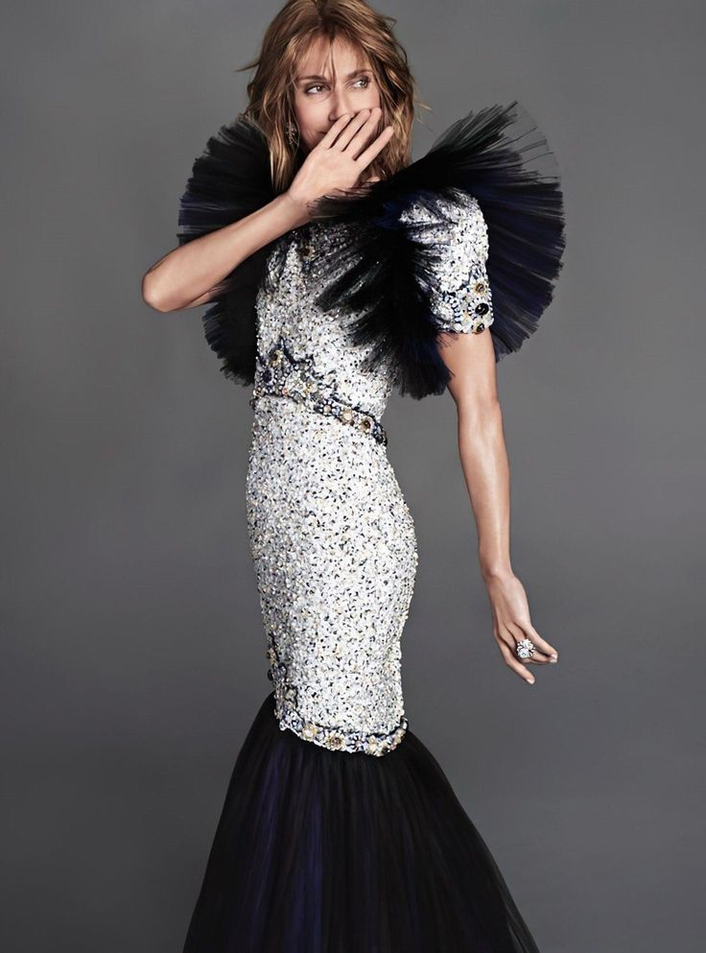
02
Fashion & Beauty

Slide 17
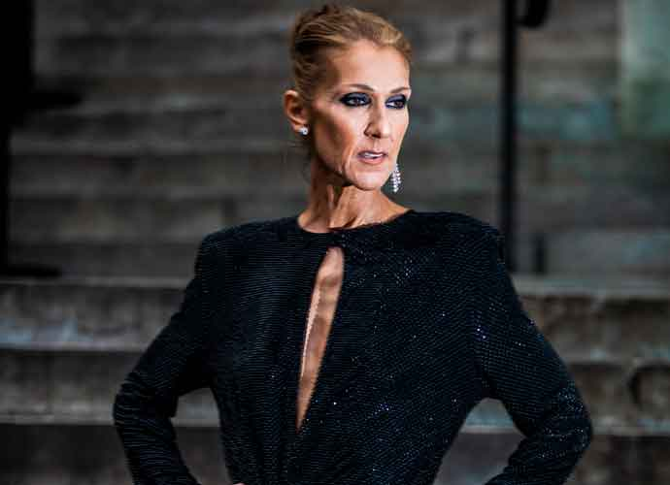
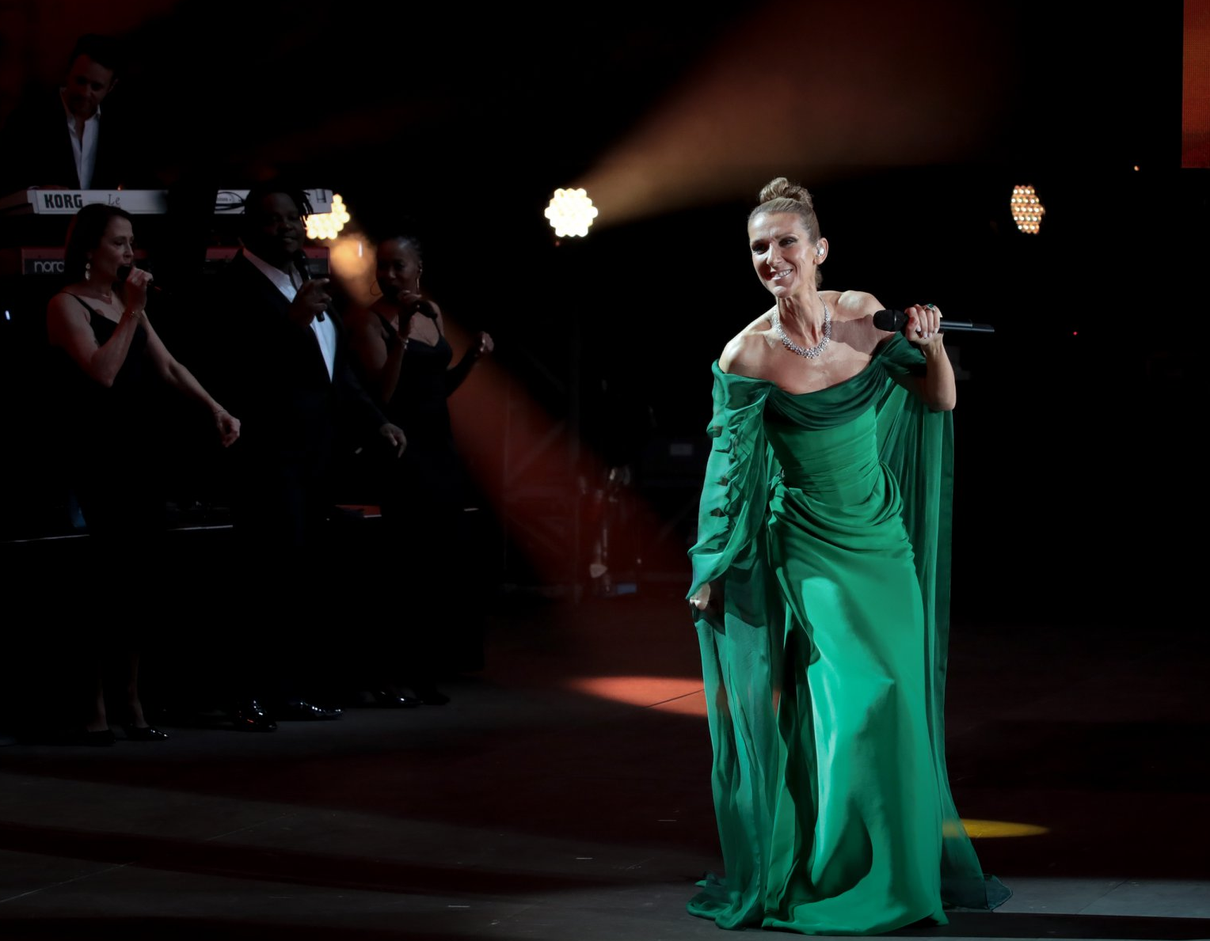
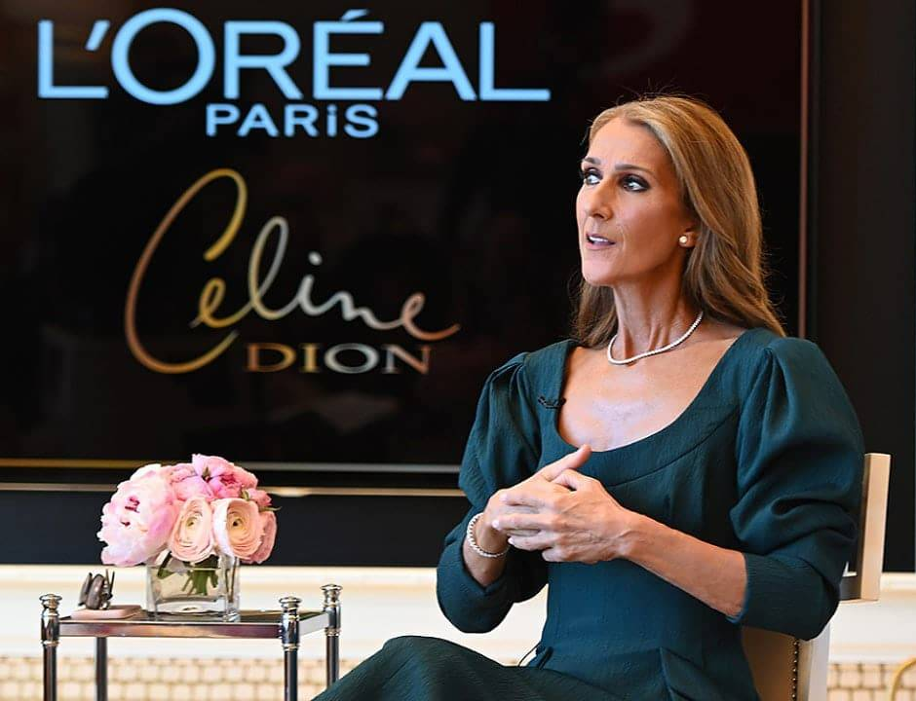
02
Fashion & Beauty

Slide 18
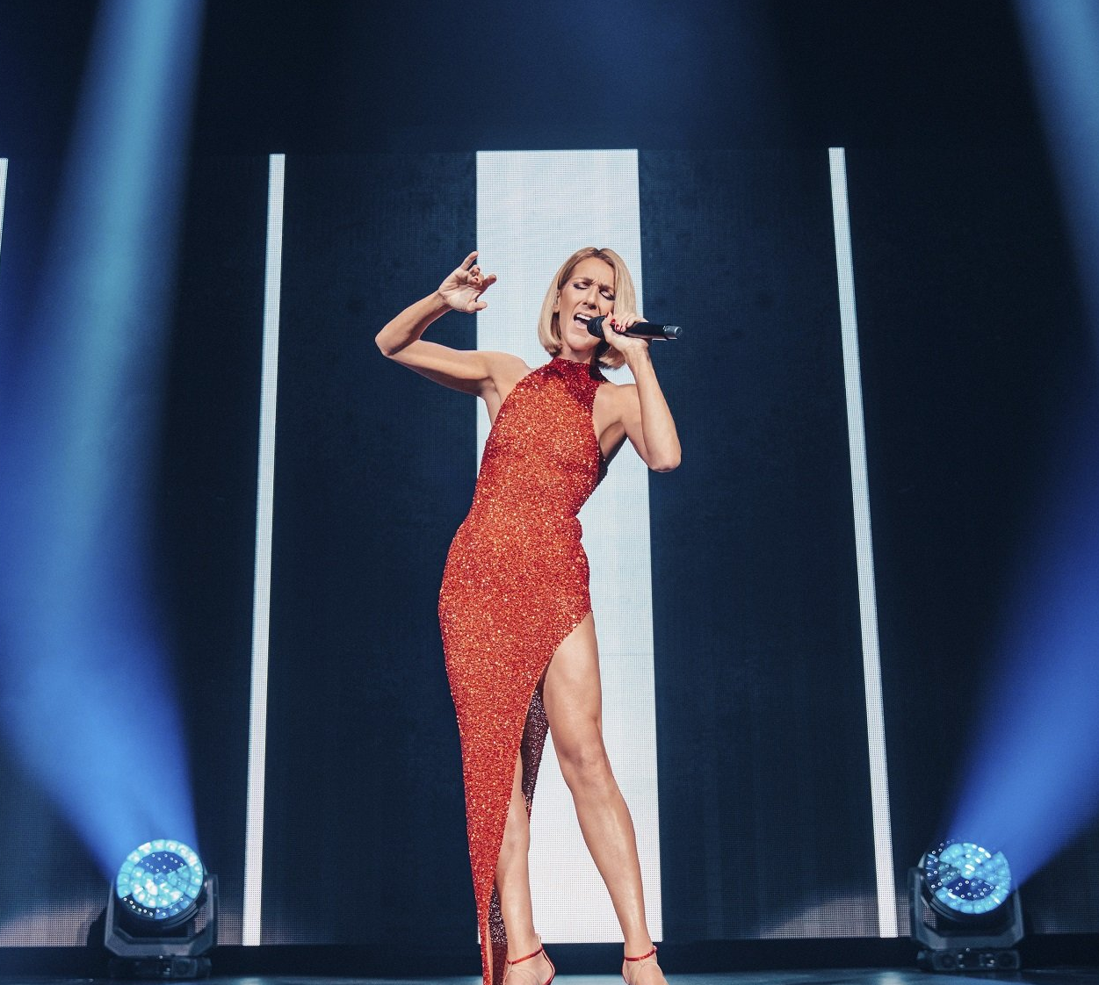

03
Car brands

Slide 19


04
Other minor sponsorships
Local brands including food and beverages, daily clothing, jewelries, etc.

Slide 20

Catering, cleaning & security
Whole package service

Slide 21

Rehearsal
All practice sessions can be online or offline
Final rehearsal is opened for ticket sales in MVM Dome

Slide 22

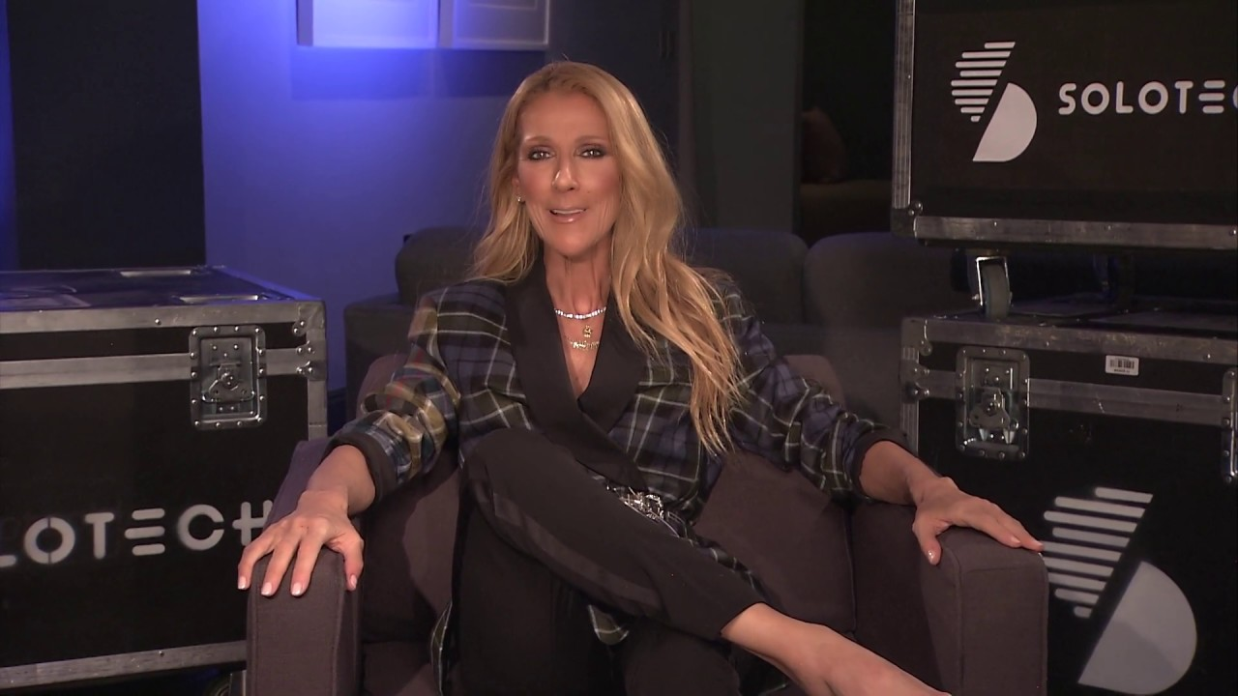
Audio, lighting, video & rigging
Solotech collaboration
Whole-package service

Slide 23

Advertising

Slide 24

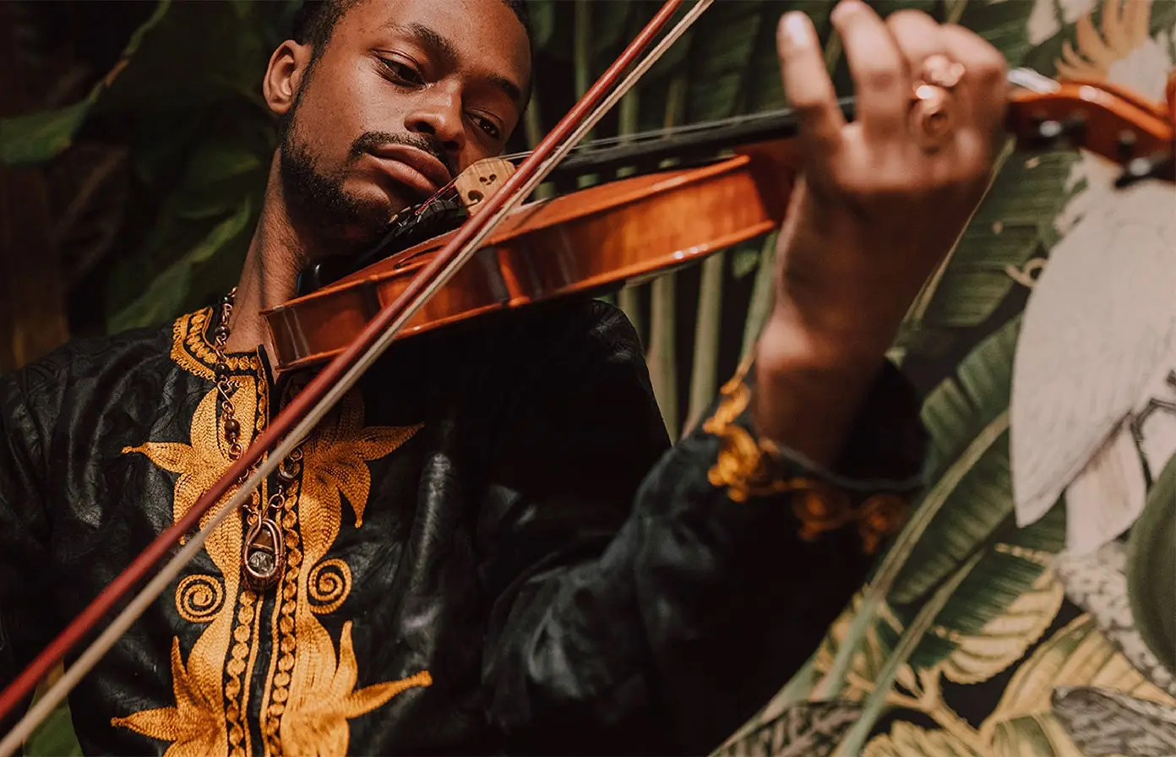
Musical instrument insurance
Supporting musicians for more than 25 years worldwide.
String instruments
Woodwind instruments
Brass instruments
Percussion and drums
Pianos and keyboards
Electronic instruments
Assembles, bands and orchestras
DJ equipment
Musical equipment
https://www.larkmusic.com/eu/musical-instrument insurance/
Contact information: +44 330 008 4870
https://www.facebook.com/larkmusicalinstruments/
https://twitter.com/lark_mi

Slide 25


Concert (event) insurance
Protection against:
event cancellation
abandonment or postponement
public liability exposures and personal accident cover for volunteers, crew and the audience
Non Appearance
Terrorist Attacks
Adverse Weather
National Catastrophes
National Mourning
Gross Revenue
Costs and Expenses
Additional Expenses
Extra Expenses
Public Relations Expenses
Loss of money at the event location
Damage to property at the event location
Chubb European Group SE Hungarian Branch Headquarters: 1054 Budapest, Szabadság tér 7, Bank Center.
Name of the company registration court: Capital Court as Cégbrísóság Company registration number: Cg. 01-17-000467
Customer service:
Tel: +36 1 487 4087*
Fax: +36 1 487 4081
e-mail: ugyfelszolgalat@chubb.com

Slide 26



TRANSPORTATION
1 mid-size car for Celine Dion
2 midibuses for artists and staffs
https://www.coachrental.eu/bus-rental-budapest/?gclid=CjwKCAiAp7GcBhA0EiwA9U0mti_qKqRnDOdEKuNta0lo8Pqwld-H37MIYhhaq8-W8miZhvTmlbpGOhoCbW8QAvD_BwE
Performance equipment 20 trucks

Slide 27
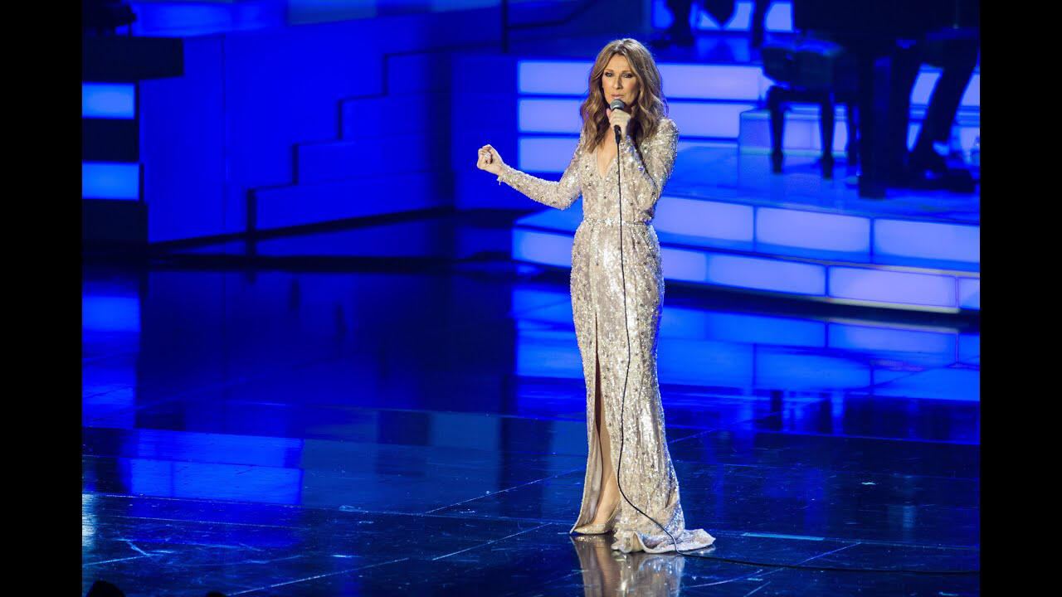
Tickets
6 different type of tickets
Price range:
20,000-99,000 huf
5 VIP packages
Price range:
95,000-215,000 huf

Slide 28
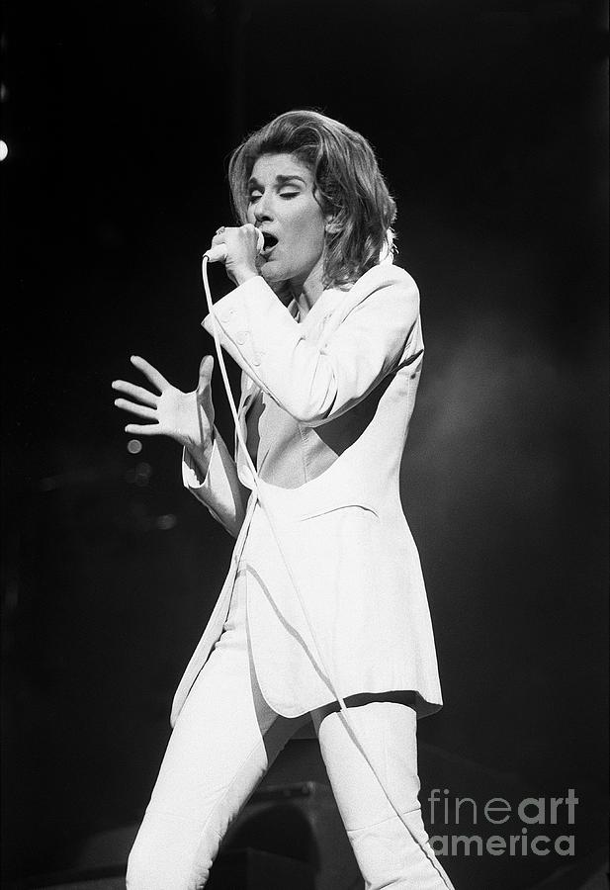
THANKS
OUR TEAM
Do Huyen Anh
Le Huong Chi
Liza Gogiashvili

